Slide 1

Visualization Fundamentals

Slide 2
Objectives
Calculate probability of an event given a normally distributed data set.
Explain how to use a normal distribution and a T-distribution to accept or reject a null hypothesis.
Explain how the mean and the standard deviation relates to a normal distribution and a T-distribution.
Some statistical charts
Visualization Fundamentals

Slide 3
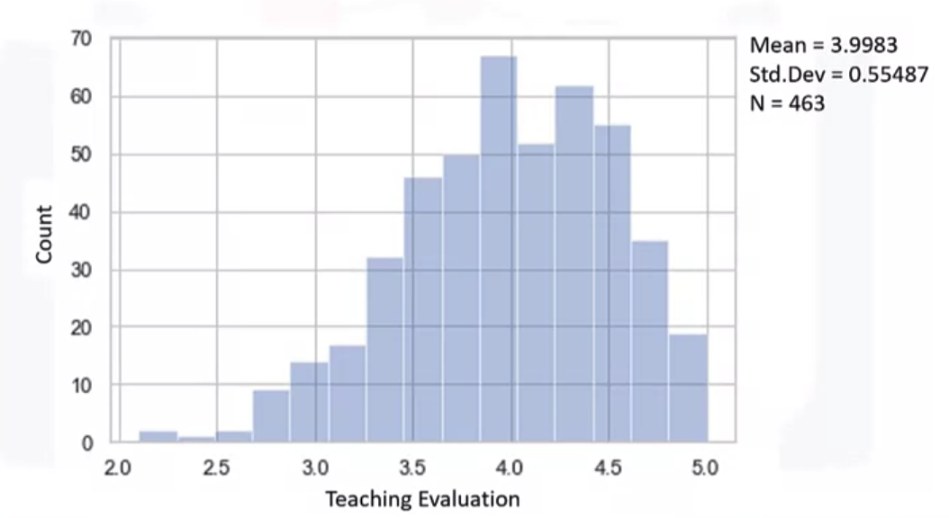
Statistical chart
Histogram – teaching evaluation score.
Visualization Fundamentals

Slide 4
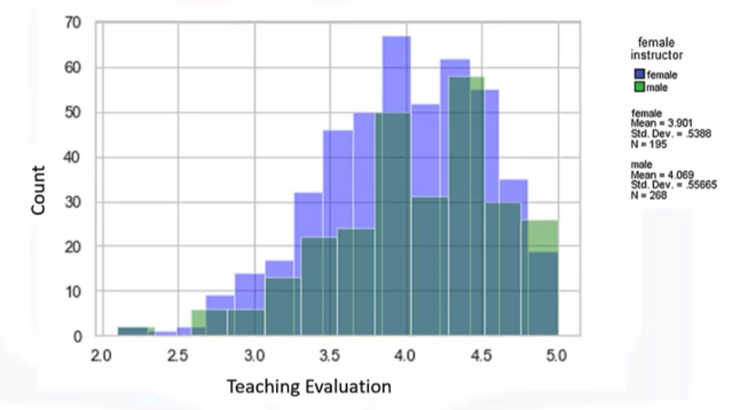
Statistical chart
Histogram –evaluation by gender.
Visualization Fundamentals

Slide 5
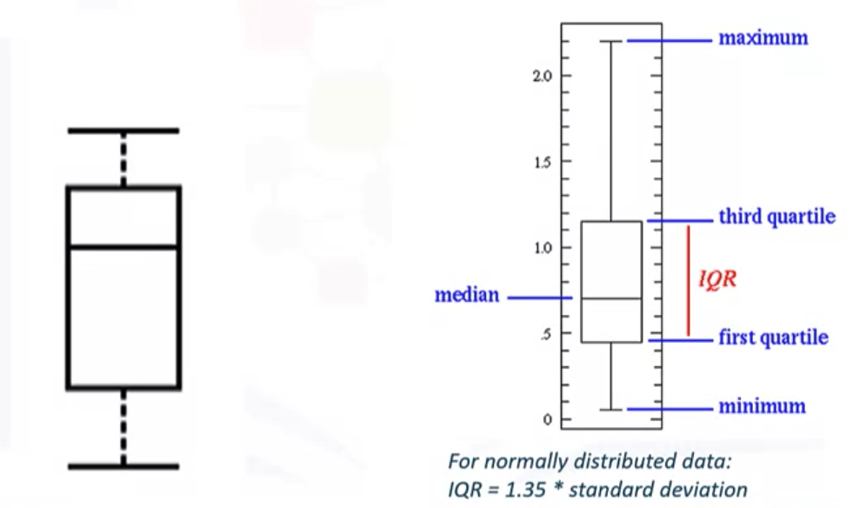
Statistical chart
Box plots
Visualization Fundamentals

Slide 6
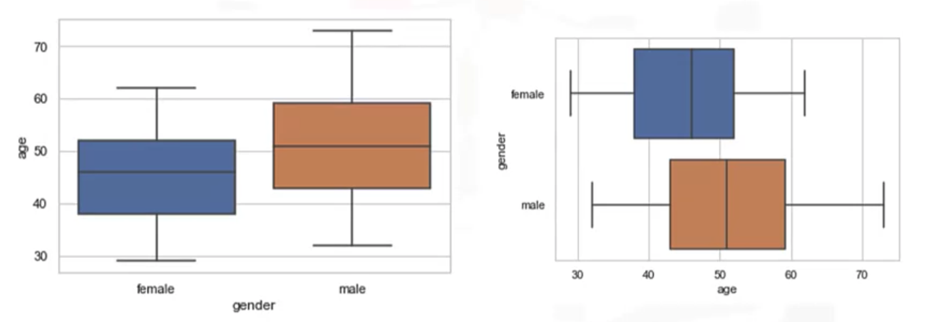
Statistical chart
Box plots- age of the instructor by gender
Visualization Fundamentals

Slide 7
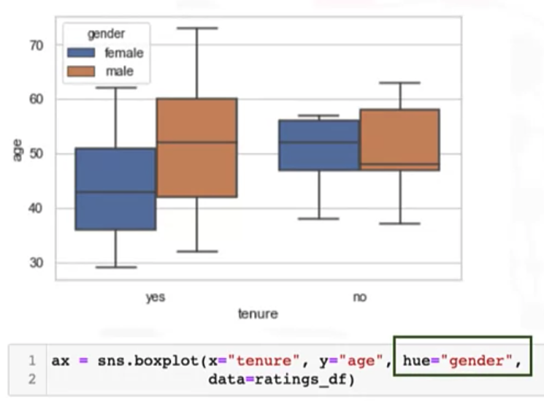
Statistical chart
Comparing age along tenure and gender
Visualization Fundamentals

Slide 8
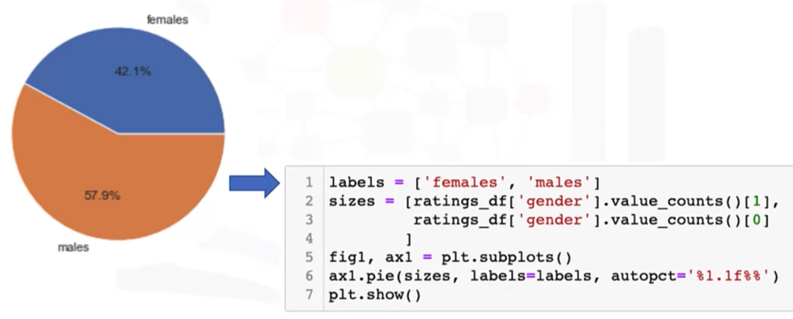
Statistical chart
Pie in the sky
Visualization Fundamentals

Slide 9
Summary
Calculate probability of an event given a normally distributed data set.
Explain how to use a normal distribution and a T-distribution to accept or reject a null hypothesis.
Explain how the mean and the standard deviation relates to a normal distribution and a T-distribution.
Discuss some statistical charts
Visualization Fundamentals

Slide 10
Q & A
Visualization Fundamentals

